Slide 1
3rd Year Projects
Eye-movement interfaces
Olveston AR garden tour
Notes:
Rozado will be client
In cooperation with design department
Email or see me for further information

Slide 2
Introduction
IN721 2015
Design and Development for Mobile Devices
Session 1.1

Slide 3
Administration
Name | Patricia Haden
Role | Principal Lecturer
Location | D308
Phone | 474-2854
email | Patricia.Haden@op.ac.nz
Notes:
I am often online evenings (except Sunday and Wednesday) and weekends, so if you need help, email me.
I am not available Sunday mornings.

Slide 4
Administration
Stream | Session 1 | Session 2
A | Tu 3-5 D207 | Th 1-3 D313
B | M 3-5 D202 | W 10-12 D207
Notes:
Please try to avoid stream hopping, as it is hard to keep them exactly in sync. We will end up at the same place at the end of the week, but the break between session 1 and session 2 may sometimes vary. If your work schedule, etc., makes this impossible, please see me to discuss
For the first weeks of the paper I will be requiring you to do any in-class practical work actually in class (as opposed to in the Project Room or at home). This allows me to observe any early problems that need to be addressed. So please make sure that your schedule allows you to remain for the entire time for both sessions.

Slide 5
Third Year Papers
More independent.
More flexible
More work
More fun
Notes:
More independent
In second year, we specify the target, and tell you how to get there. In third year, sometimes we just specify the target, and you have to figure out how to get there by yourself. This is to prepare you for the job, where pretty much nobody ever tells you anything but what you’re supposed to deliver.
More flexible
As much as possible I want you to be able to make things you care about. Therefore, assignments will generally be designed to give you a lot of latitude. You get general specs or FR, but you can often hit them in a personalised way
More work
At 3rd year you are expected to spend twice as many hours outside of class as there are scheduled teaching hours. That is, in addition to the 4 hours a week you spend in class, you are expected to spend a minimum of 8 additional hours working on your own. The practicals and assignments assume this much commitment, so be sure to schedule it in.
And absolutely do not fall behind. This is a “scaffolded” paper. That means that topic n builds on, and assumes mastery of, topic n-1. If you fall substantially behind, you will probably not be able to catch up. If it is unavoidable, due to health or family issues, see me VERY PROMPTLY.
Remember, this is 3rd year – there are no convenient do-overs.
More fun
Because of the above.

Slide 6
Content
Development of Mobile Applications
Android
Java
Design of Mobile Applications (HCI)
Design for general usability
Human perception and cognition
Specific issues in mobile – UI and UX
Notes:
We are using Android because the software is open source, the community is large, it is easier to deploy that iOS and has a bigger market share than Windows.
Remember that, as always, it’s not about the particular tool or language or environment, it is about the underlying principles, that you want to learn well enough to generalise to whatever tool/language/environment you need.
We will be coding in Java, but the libraries and architectures are very Android-specific.
If you learned everything in C++, you should l be fine in this paper. If you didn’t take C++ or you didn’t learn everything in there, please schedule in some extra time in the first few weeks to get your coding skills up to speed.
We are not referring here solely to look and feel, but to broader issues of usability and user experience.
The design of mobile applications is complex and interesting, and introduces some new issues to the general principles of HCI.
To address this, however, we must first start with those general principles, which we will do, before addressing the particular concerns of mobile.

Slide 7
Provisional Schedule
Week | Session 1 | Session 2
1 | Course Introduction Quick Start | Event handlers
2 | Android framework core | Universal Design Principles
3 | Controls for Interactivity 1 | Visual and Auditory systems
4 | Controls for Interactivity 2 | Dialogue Fragments
5 | Intents (advanced) | Screen Design Principles
6 | External data files | Learning and Memory
7 | Data storage | DBs
8 | Using the camera | Location-based services
9 | Networking | 3rd Party APIs
10 | Project work | Project work
11 | Application testing (real phones too) | User testing techniques
12 | Project work | Project work
13 | User testing methodology | Real user testing
14 | Deployment | Deployment
15 | TBA | TBA
16 | Exam prep | Exam
Notes:
Absolutely, positively subject to change.
For example, we’ve got a problem where the stream with a Monday class is going to lose a session because of Something Something holiday. We will work it out as it comes up.
This is just to give you a general sense of what we will be covering, in case you want to do some reading ahead, or suggest additional stuff that is missing.

Slide 8
Assessments
Component | Weight | Comments
In-class practicals | 20% | Due dates will be strictly enforced Submitted code that does not have your username in the application file name will not be accepted.
Project | 50% | Three parts: Beta version User testing and consequent modifications Final release Marks based on design and code quality and functional robustness
Exam | 30% | All course material presented in class and/or covered in the readings is examinable.
Notes:
Complete details as they arise
Note the stricter requirements for 3rd year.
We will submit via email, not via gitHub, due to privacy issues.
If it doesn’t have your name on it, I won’t even open it.
Note the user testing. This is a very technical process and is a requirement for the majority of 3rd year projects, so we’ll do it thoroughly in this paper.
Readings assigned as they come up.

Slide 9
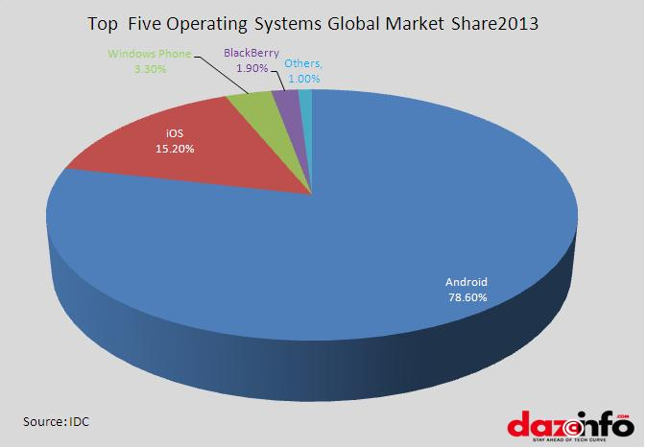

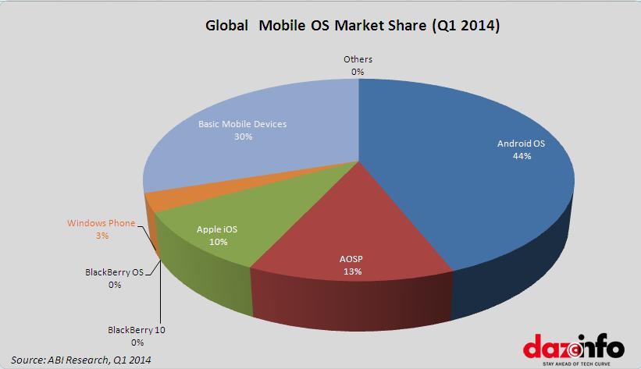
Introduction to Android
Notes:
The Mascot
And the market share. These values differ depending on source (can you think why that would be)? But Android always has the biggest slice of pie.
One thing to note – look at the picture when you include feature phones. No apps. No Safari/Chrome/etc.
We talk about how to provide service to these users in Web3.

Slide 10
The Android Platform
An end-to-end mobile application development and execution platform.
Initiated in 2007 by the Open Handset Alliance
Open source and nonproprietary
Development
Java with Android libraries
Until very recently, Eclipse using Android plug-ins.
Android Studio (first stable build released December, 2013).
Notes:
An end-to-end mobile application development and execution platform.
Not unreasonable to think of it as both the development tools, the execution environment and the operating system. So sort of like Visual Studio + the .NET framework + Windows, but only for mobile devices.
Initiated in 2007 by the Open Handset Alliance
OHA a group of hardware manufacturers, telecoms companies and software developers (including, of course, Google).
OS
Based on Linux
Makes it a feisty competitor to Apple and Blackberry’s proprietary tools
Development
We will talk about Android Studio, but sensible professionals avoid the bleeding edge. Most of the available resources are for Eclipse development, and most development will be in Eclipse for a long time. Pick up the newest things for hobby projects; don’t expect to impress employers with them.

Slide 11
The Android Computational Model
Multiple apps run simultaneously, each in its own “security sandbox”.
“..each app, by default, has access only to the components that it requires to do its work and no more.” - developer.android.com
Apps communicate via messaging, allowing them to share data and services.
Notes:
That is, each app running on your phone is running inside its own virtual machine.

Slide 12
Android Computational Entities
Activity
The classic “app” is composed of multiple Activities.
A single screen with associated interface definition and computation.
Can communicate with other Activities (including those in other applications) via messaging.
All activities descend from android.app.Activity
Notes:
Activity
This is how the normal sort of app we think of as “things that run on your phone not in the browser” is built.
Interface definition: Think of it like the HTML that defines a web page, or the “designer.cs” part of a C# application that declares all the screen controls and their properties.
So if you have a game on your phone that has a splash screen, settings, high scores and the actual play, it probably has four separate activities.
We will look at the messaging model in detail as we go along.
Android programming is just Java programming using the Android classes. The way Visual C++ programming is just C++ programming using the .NET classes. So the bulk of the learning will be in getting to know those classes and how to use them.
They will seem pretty weird at first, so think always about why the designers built them this way.

Slide 13
Android Computational Entities
Service
Has no interface.
Runs in the background and performs work for other components (e.g. Activities).
Content Provider
Data manager
Exposes a standard API for other computational elements to access the data.
Broadcast Receiver
System-wide listener
Notes:
There are also these other ones.
We will see them as we go along, but when people think about “building an app” they are thinking primarily about working with instances of the Activity class.
Service
E.G. Database pipeline, audio driver
Content provider
E.g. There is a content provider that manages your contacts. It can be queried by any app running on the phone.
Broadcast receiver
Lurks around listening for system-wide events (e.g. Turning off the phone) and routes consequent messages.

Slide 14
Android Computational Communication
Activities, Services, Content Providers and Broadcast Receivers are highly interactive.
Any app can ask to transfer control to any other app’s components (directly or indirectly).
Apps register the work they can do.
When work of a given type is requested, the system looks dynamically for some entity that can do it.
This communication performed via Intent objects
Notes:
Directly:
“Start Bob.methodName”
Indirectly:
“Start somebody who can get me the GPS reading”
This messaging behaviour is very interesting, and is one of the things that most distinguishes Android from other operating systems.
It provides a lot of efficiency, because you don’t have to be always writing your own code and running your own processing threads, if there is someone out there already who can do it for you.
Intent objects are just another Android class. They manage the information that the system needs to get all this inter-application communication going. We will look at them in lots of detail later on.
So, there’s a lot of high level stuff going on in the Android system. But for the developer, it starts with creating your own apps, and those apps consist of one or more Activity instances, or simple “activities”.
Very shortly, we will see how to do that in Eclipse. First, though, we need to see how an activity behaves...

Slide 15
The Activity Lifecycle
Activities are event driven.
We will write code for events in the Activity Lifecycle.
Notes:
This should be quite familiar.
You have written code for OnClick events and Form_Load events, right?

Slide 16
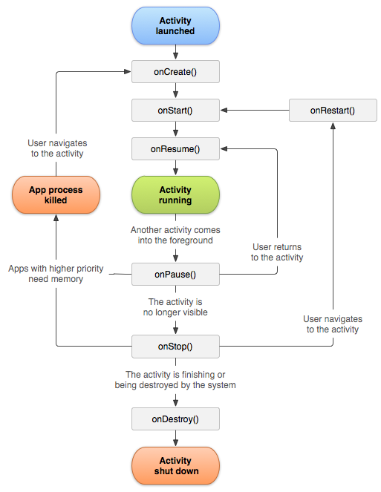
The Activity Lifecycle
Notes:
From android.com
This should be quite familiar.
You have written code for OnClick events and Form_Load events, right? As in those cases, it’s all about figuring out where to put what.
onCreate:
Called when the activity is first created. Before it appears on the screen.
onStart:
Called when the activity gets the screen.
onRestart:
Called if you’ve been stopped, and now are getting control back. Always followed by onStart
onResume:
Called when the activity is in the foreground accepting user input. Happens if you have been backgrounded (paused) and are now being foregrounded. All called somewhat trivially after onStart.
onPause:
You’ve been backgrounded, but not killed. However, if memory gets tight, you can get killed. If that happens, when the user foregrounds you, you have to be recreated. Think about the implications of this for what code goes in the onCreate and onPause handlers.
onStop:
You lose your screen handle. You are about to be killed. Not always called, if you get killed from the pause state.
onDestroy:
You’re losing your memory. This may be voluntary because you are shutting down, or involuntary because the system is freeing up memory.
To get started, we’re going to worry mostly about onCreate. But in more advanced scenarios, you would want to think about all the necessary initialisation, reinitialisation, clean-up, data saving, etc., that you require, and where it needs to go.

Slide 17
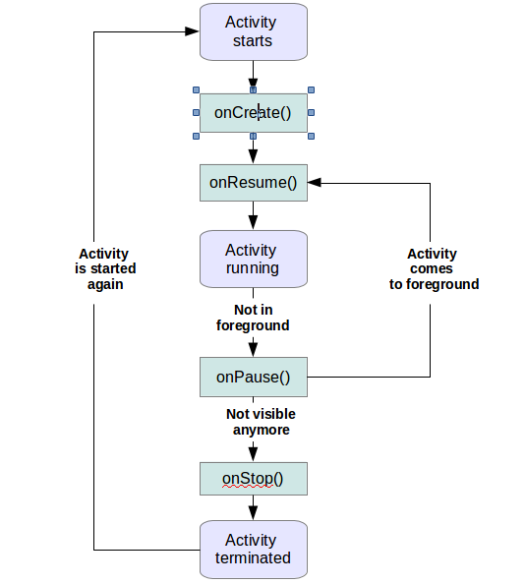
Simplified Activity Lifecycle
Notes:
From vogella.com
Many people find this version clearer, as it highlights only those events you are really likely to want to write code for.
This site, written by Lars Vogel (author of Eclipse), has lots of good Android stuff on it.
As always, be choosy about your online resources. There is a lot of stuff out there that is badly done and lots that is simply wrong.
Also as always, avoid stackOverflow for basics. Much better to use the official documentation or a professional written and edited textbook.

Slide 18
Android Development with Eclipse
Use Eclipse (Juno) with the Android Development Tools plug-ins installed.
Best practice: Use “ADT Bundle”
(Should be) installed on all OP machines
Available as a single folder on the L drive for laptop users
Notes:
Lots of older books will go through the install process.
Much better to use the ADT bundle
Unfortunately, Google is now hiding the ADT bundle, as they promote Android Studio. (This is dumb.)
Fortunately, we have the code you need.

Slide 19

First Android App
Notes:
We will look briefly at some bits of the process together, to highlight a couple of important (yet strangely trivial) mechanical issues.
DO NOT WORK ALONG WITH THIS, just think, absorb, take some notes.
Then you will have a go on your own machines.
The purpose of this practical will be mostly to check that the machines and your accounts are working...
On the student machine, you will need to find the eclipse desktop short cut and click on it. (Don’t do this now.)
NB: There have been several versions of Eclipse installed and uninstalled and messed about with on the student image this summer, as Dale and I explored the various options for this paper and the Java paper.
For IN721, YOU NEED JUNO.
If you launch and get Kepler, you’ve got the wrong version, so hunt around for another eclipse folder. The one you want will be at the same level as another folder called sdk, which contains the Android stuff.
If you grab the version off the I drive, it should be the correct folder.

Slide 20
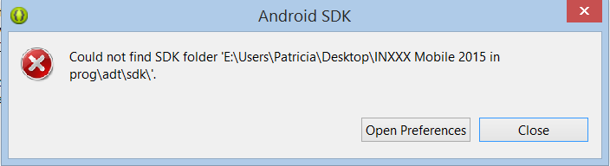
First Android App
Notes:
If you see something like this, don’t panic.
Eclipse hardcodes some paths. If you move any folders around (or if ISS moves them for you), it can lose what it needs.
You’ll just need to relocate it.
Just click the Open Preferences button...

Slide 21
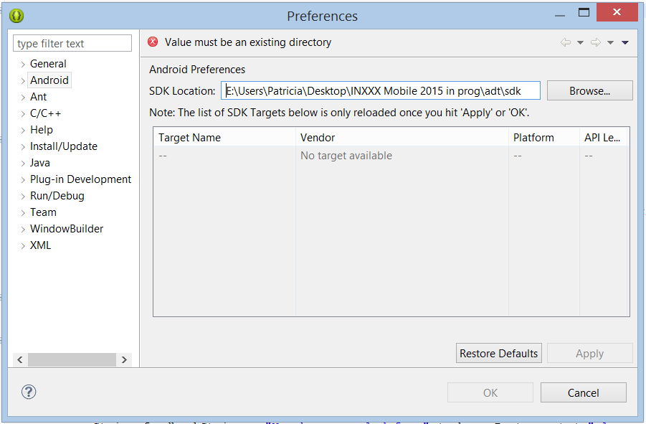
First Android App
Notes:
..and Browse to that sdk folder.
Remember, it is at the same level (i.e. In the same directory) as the eclipse folder itself.
You may want to compare, at this moment, the way Eclipse differs from, say Visual Studio. Eclipse is more flexible, so requires more user independence. Visual Studio does everything for you, but locks you down hard to its way of doing.

Slide 22
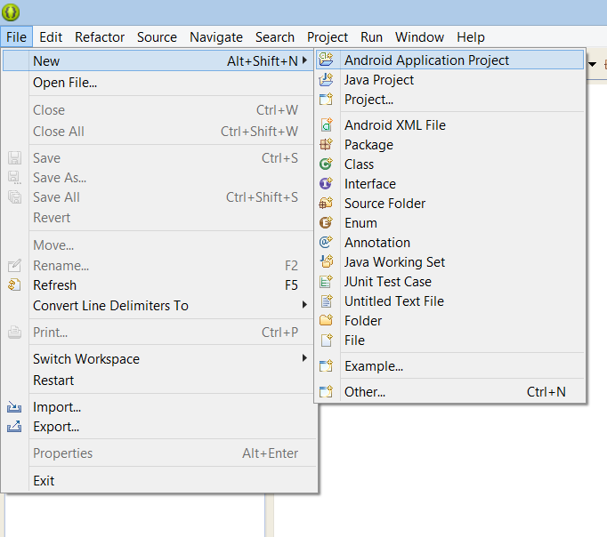
First Android App
Notes:
This is how you will create Android apps in this paper.
If you have a different menu setup – especially if Android Application Project is not at the top of this menu, but is down in “Other”, you do not have the correct version of Android.
We want to have access to the latest version of Android for this paper. That is 5.0 (“Lollipop” – all the versions of Android have been named after sweets). If you have it installed correctly, this is the menu structure you will see.
The student install, and the folder from the I drive will have 5.0. If you already have an Android/Eclipse set up and don’t have 5.0, use Window->Android SDK Manager to get it.

Slide 23
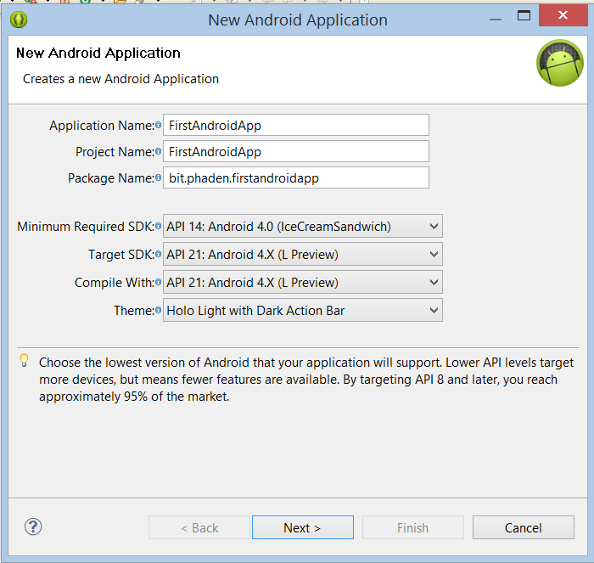
First Android App
Notes:
There are a lot of settings and a lot of options
When you are developing on your own, you will make various choices for these.
For class work, I am going to require some aspects of the configuration.
This ensure that when I refer to features, you will have them, and to facilitate some automated marking systems of mine.
Please be conscientious in following these requirements – consider it practice for the rules you will encounter on the job.
The requirements are:
Your package naming protocol must be: bit.yourUsername.applicationName. All lower case.
Your target SDK range will be 14/4.0 (because we want stuff that isn’t available until then) to 21/4.X (because that’s the current one). Android has evolved so rapidly in the last four or five years, that developers must grandfather vigourously, and support a range of APIs. This is a sensible range for development at this moment. See the docs for more discussion of the history of the versions.

Slide 24
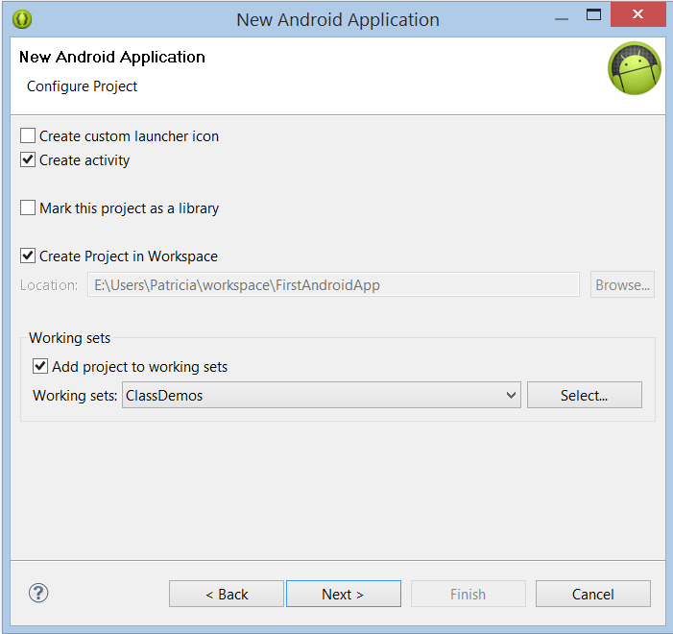
First Android App
Notes:
It is possible to create an app that has no activities, but this is like creating a .NET project with no forms. It can do stuff, but you won’t see anything.
In the first weeks of the paper, we want to see things, so go ahead and let Eclipse make an activity for you. It will place it in the correct location in the file structure, set the build up right, and give you a little starting code template.
Handle your workspace and working sets as you set fit; you should know how to do this from Programming 3. Do keep in mind that if you are working locally, anything you put on the C: drive will be erased on reboot.

Slide 25
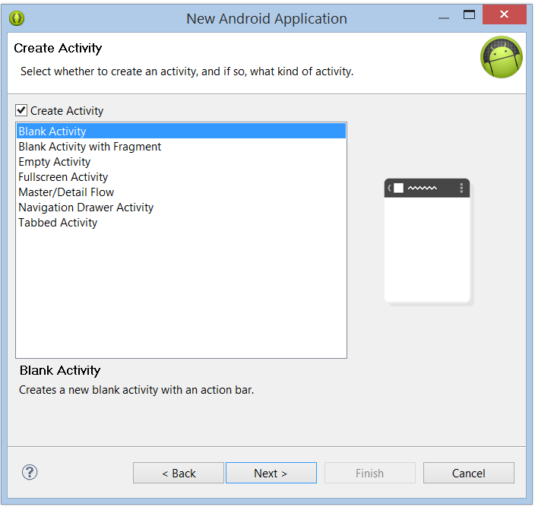
First Android App
Notes:
For now, choose a blank activity.
The various templates will eventually save you time, but they require lots of customisation, so before you can effectively use them, you need to know what you’re doing.

Slide 26
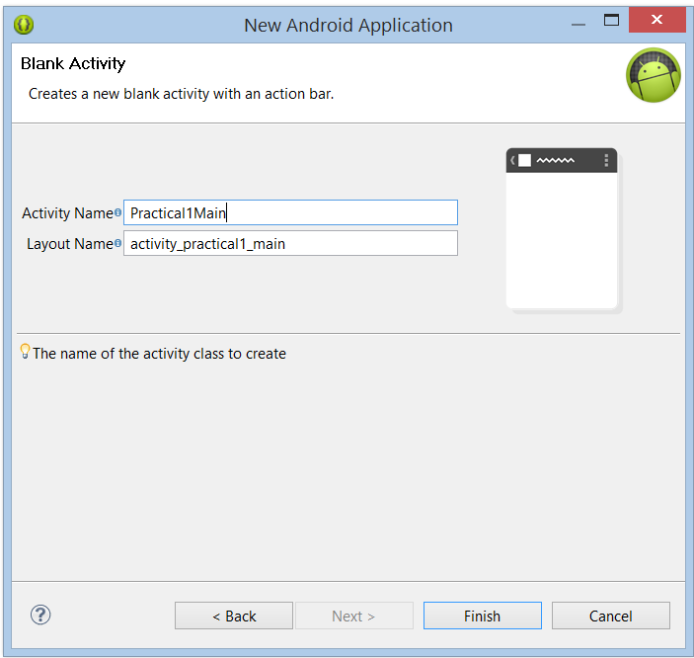
First Android App
Notes:
Recall that your Activities will correspond (in most cases) to the screens of your app.
You need to make sure that they have sensible names.
In this dialogues, you type the Activity Name, and Eclipse fills in the Layout Name.
As we will see in a minute, each activity has two files: one that holds the code (the Activity descendent class you are about to create) and one that specifies the screen interface (in XML – we’ll see it in a minute).
That screen interface file is called the Layout. Eclipse is going to make it for you automatically, and here it shows you what it is going to call it.
Eclipse is clever about this. The layout file name has to be all lower case. So when you use normal camel notation for your class name (the Activity name), it “translates” it into underscore notation as shown.

Slide 27
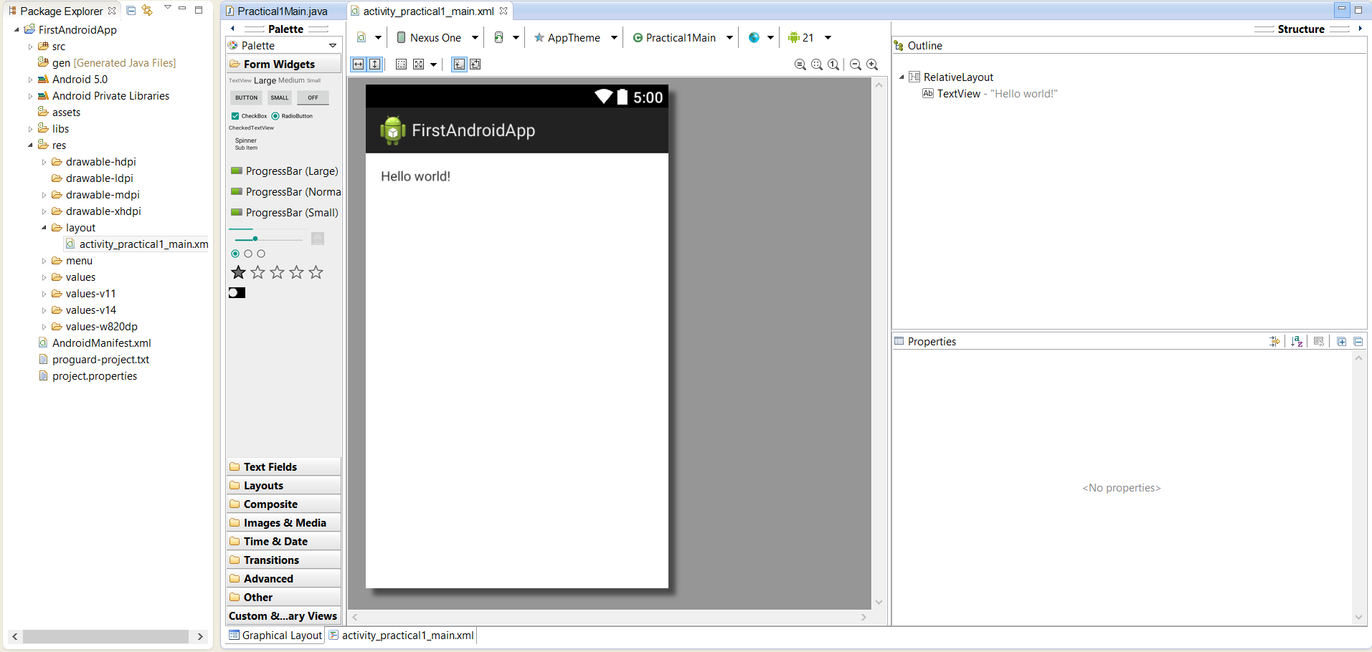
First Android App
Notes:
Here’s what you get.
You’ve got a bunch of files, which you can see in the Package Explorer
You’ve got an editing area, where there are two files open – the two tabs.
Practical1Main.java is where the Activity class is
Activity_practica1_main.xml is the layout. At the moment we are seeing it in WISYWIG, but we can switch to source view with the tabs at the bottom.
On the WISYWIG there are some palettes from which you can drag and drop screen elements – some visible and some not.
On the far right there are useful panels for various things.
As always when getting to know an IDE, you don’t want to try to cope with everything at once, you want to get to know the parts thoroughly, from the most essential outward.
That’s what we will do over the next couple of sessions.
Today we will talk briefly about the various files, then you’ll start your practical.

Slide 28
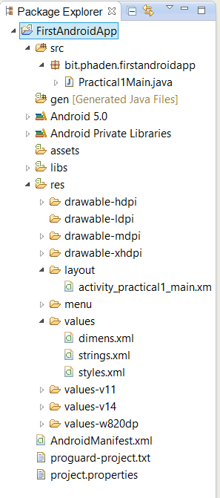
First Android App
Practical1Main.java
/gen
activity_practical1_main.xml
/drawable-****
/values/*.xml
AndroidMainfest.xml
Notes:
All these files. Android has a fixed file structure which you must follow.
Some of these we won’t use yet, so ignore them.
Here are the ones you care about today
Practical1Main.java is your activity class. We will look at its code in a minute
/gen. There is nothing in here at the moment, but Eclipse is going to build a VERY IMPORTANT class in here called R. The class R will wrap all your project resources (e.g. Images, constants like colours and sizes, even important literal strings) into static elements. You will then be able to access all that stuff in a clean and uniform way in your code.
NB: R frequently gets out of date as you add and change things, and you must build your project to get it regenerated. Android development is 87.4% rebuilding to update R.
Your layout XML file, buried down there in res/layout. That’s where these things go. More frequently than in Visual Studio, you will generate new project elements by hand. YOU HAVE TO PUT THEM IN THE RIGHT PLACES. So pay attention to that.
Drawable folders. Images will go in here. You can may versions of your images, at different resolutions. Why do you think that is? => Mobile devices are heterogeneous, and you need to accommodate a very wide range of targets.
The folder values, which contains three xml files. You will put more xml files in here as needed. These hold configuration constants. Like the hex value of a common background colour. They get bundled up into R and you access them from there. The rationale for separating these out is similar to that for pulling such things out into the CSS. If you decide to change your font size, for example, you need to modify it only in the single location, not the code for every control that uses it.
AndroidManifest.xml. Project meta data. Heaps of stuff in here. Has its own extremely complicated wizardy thing for editing; can also be edited by hand as XML (often easier to do). You will discover that Android is less automated about its metadata than Visual Studio, so we’ll be looking at this quite a lot.

Slide 29
Before we can start….

Slide 30
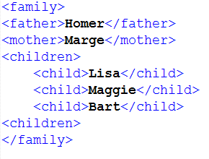
XML
Notes:
Like HTML, except you make up your own tags.
Allows representation of any hierarchical organisation
Use attributed to add extra bits of information.
For example.
Note that, unlike HTML, there is no “standard” for XML. You literally make up any tags you want.
As long as the nesting is correct (i.e. One outer tag to hold them all, outer elements completely enclose their inner elements, and every open tag has a close), it’s syntactically correct XML.
So, different people can choose to represent the same information in different ways.
For example, I can define a family this way. You might do it differently – siblings instead of children, a guardians element that contained mother and father, elements for aunts and uncles, etc.

Slide 31
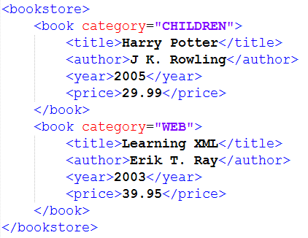
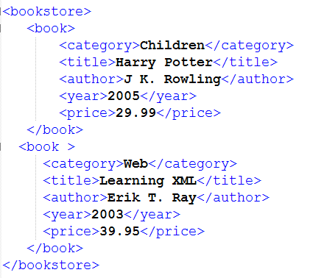
XML
Notes:
Here is another example:
Assume you want to represent the inventory of a bookstore in XML
Here is one way....
Here is an alternative, where category has been defined as a component element of <book>, not as an attribute.
Both are completely legal.
People using XML together must agree on what tags they want to use, who contains whom, and what goes in attributes and what goes in values.
As long as we are agreed on the rules, we can share information and write code to process that information.
Modern SDK’s will have built-in tools for parsing XML. So you can give it an XML text file as input and then ask for “all the child elements” or “the value of mother”, etc.
Here is what the XML for an Android screen layout looks like.

Slide 32
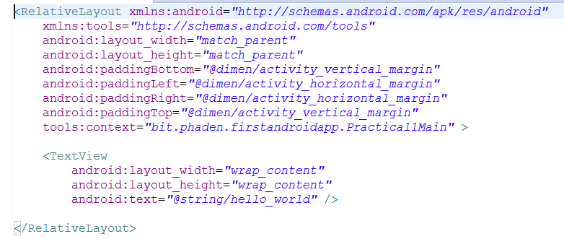
XML
Notes:
This file is /res/layout/activityName.xml
For the example app created in the Powerpoint, the XML is:
This is syntactically correct XML -- a <TextView> element, contained within a <RelativeLayout> element.
Note however, that, unlike many XML contexts, all of the information about these elements is expressed with attributes in the opening tag.
The <RelativeLayout> for example, contains 9 different attributes, all with lengthy value strings before its closing angle bracket.
This is the Android/Eclipse way. Do we like it? No. IT is ugly and hard to read. Will we learn to do it anyway? Yes.
We will look in detail at all these various tags, attributes and values as we go. For now, realise that everything you set in the Properties window in Graphical View will appear in this XML file as an attribute.
Note that the values of these attributes are, in some cases, expressed as android system constants (e.g. match_parent) and sometimes as strings that begin with @ and a file path. These latter strings are references to items that have been entered into one of the xml files in the /values folder of your app. For example, the string @dimen/activity_vertical_margin refers to an XML element of type <dimen> with name attribute "activity_vertical_margin" contained in the file /values/dimens.xml.

